Slide 1
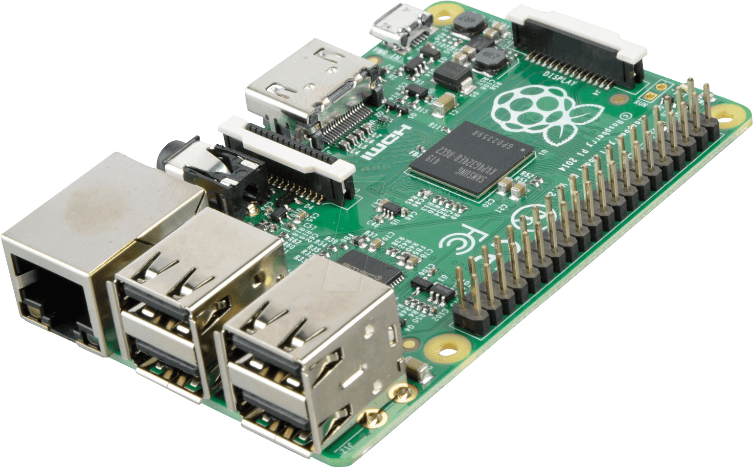

Pertemuan 7
Image Processing Part 3
Capture Photo from Camera
Save Image to Disk
Thresholding Otsu
Belajar
Image Processing di Raspberry Pi

Slide 2
Capture Photo & Save

Slide 3
Preparation
1. Pastikan Kamera sudah terpasang pada Raspberry

Slide 4
Preparation
2. Pastikan Kamera sudah di enable pada Raspberry
Buka Terminal Raspberry Pi di VSCode
jalankan command berikut :
selanjutnya, pilih Interfacing option
gunakan keyboard key arrow up (↑) dan arrow down (↓) untuk navigate,
dan enter (↵) untuk select
selanjutnya pilin, enable/disable camera
pilih Enable dan OK
sudo raspi-config

Slide 5
Capture & Save Photo
Import library (OpenCV, Matplotlib)
Display Image
import cv2
import matplotlib.pyplot as plt
import os
def show_image(img, title= 'my image', size=(10, 7)):
img_reverse = img[ :, :, ::-1]
plt.figure(figsize=size)
plt.imshow(img_reverse)
plt.title(title)
plt.axis('off')
plt.show()
show_image(img, title= 'captured photo')
Capture Photo
cap = cv2.VideoCapture(0)
ret, img = cap.read()
cap.release()
Save Photo
cv2.imwrite('photo_001.jpg', img)

Slide 6
Capture & Save Photo - Pengaturan Ukuran
Capture Photo
Display Image
cap = cv2.VideoCapture(0)
cap.set(cv2.CAP_PROP_FRAME_WIDTH, 320)
cap.set(cv2.CAP_PROP_FRAME_HEIGHT, 240)
ret, img = cap.read()
cap.release()
def show_image(img, title= 'my image', size=(10, 7)):
img_reverse = img[ :, :, ::-1]
plt.figure(figsize=size)
plt.imshow(img_reverse)
plt.title(title)
plt.axis('off')
plt.show()
show_image(img, title= captured photo')
Save Photo
cv2.imwrite('photo_001.jpg', img)
cap.set(cv2.CAP_PROP_FRAME_WIDTH, 320)
cap.set(cv2.CAP_PROP_FRAME_HEIGHT, 240)
Set ukuran phpt yang dihasilkan dengan
lebar x tinggi = 320 x 240

Slide 7
Capture & Save Photo Kode Keseluruhan
Keseluruhan Kode capture photo & save Image
import cv2
import matplotlib.pyplot as plt
import os
cap = cv2.VideoCapture(0)
ret, img = cap.read()
cap.release()
cv2.imwrite('photo_001.jpg', img)
show_image(img, title= captured photo')

Slide 8
Capture & Save Photo dalam Function
capture & save photo dalam function dengan cama capture, selanjutnya kita dapat gunakan fucntion tersebut untuk capture photo & save
def capture(filename='photo.jpg'):
cap = cv2.VideoCapture(0)
ret, img = cap.read()
cap.release()
cv2.imwrite(filename, img)
return img
img = capture('photo_002.jpg')
show_image(img, title= 'captured photo')

Slide 9
Capture & Save Multiple Photo
buat folder dengan nama photo
n_photo = 3
for i in range(n_photo):
name = 'photo_00%d.jpg' % i
img = capture(name)
show_image(img, title= name )

Slide 10
Thresholding Otsu

Slide 11
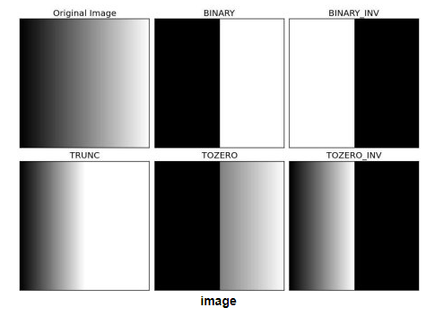
Thresholding
Image Binarization/Thresholding adalah proses membuat sebuah gambar menjadi hitam putih (image hanya memiliki nilai pixel 0 atau 255) dengan menerapkan batas threshold tertentu.
Menggunakan method cv2.threshold(img, threshold_value, max_value, threshold_type)
Untuk :
img : input image
threshold_value : The thresh value with respect to which the thresholding operation is made
max_value : The value used with the Binary thresholding operations (to set the chosen pixels)
threshold_type : One of the 5 thresholding operations.
cv2.THRESH_BINARY
cv2.THRESH_BINARY_INV
cv2.THRESH_TRUNC
cv2.THRESH_TOZERO
cv2.THRESH_TOZERO_INV

Slide 12
Threshold Binary on Image
Import library (OpenCV, Matplotlib)
Display Image
import cv2
import matplotlib.pyplot as plt
import os
def show_image_binary(binary, title= 'my image', size=(10, 7)):
plt.figure(figsize=size)
plt.imshow(binary, cmap='gray')
plt.title(title)
plt.axis('off')
show_image_binary(binary, title= 'threshold binary image')
print('threshold value : %d' % ret)
Read Image
img = cv2.imread('path/to/filename')
Threshold
ret, binary= cv2.threshold(img, 230, 255, cv2.THRESH_BINARY)

Slide 13
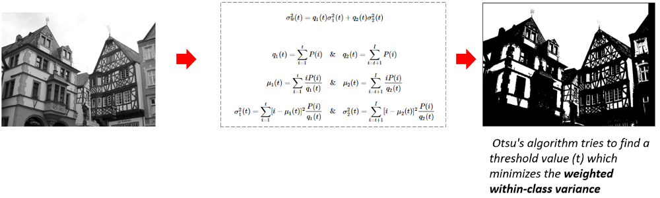
Thresholding Otsu
Metode otsu merupakan metode untuk menentukan titik ambang batas optimal untuk melakukan thresholding.
Hal ini dilakukan dengan meminimalkan variansi intrakelas,
Dan memaksimalkan variansi antarkelas dari kelas-kelas yang dipisahkan dengan threshold

Slide 14
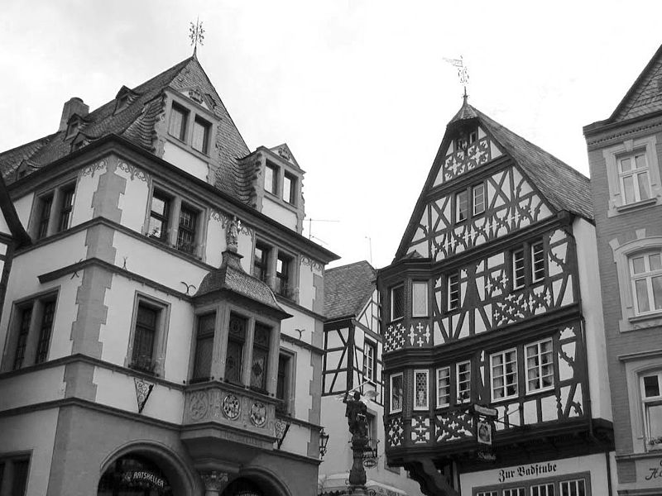
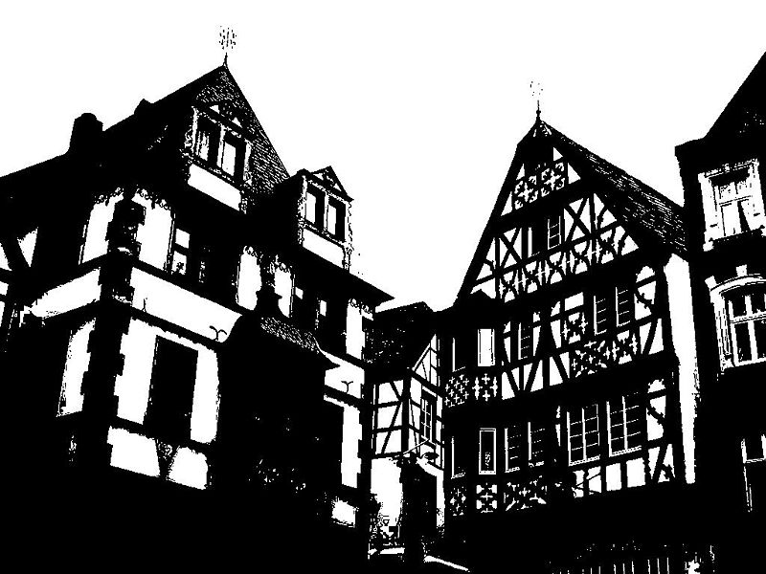
Thresholding Otsu
Otsu's method visualization

Slide 15
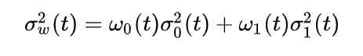
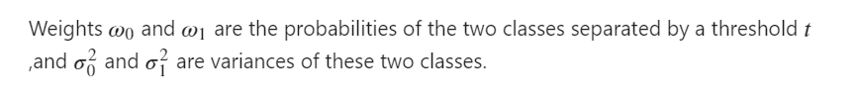
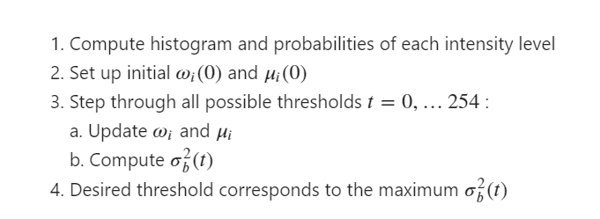
Thresholding Otsu
Notes:
https://en.wikipedia.org/wiki/Otsu%27s_method#:~:text=In%20computer%20vision%20and%20image,two%20classes%2C%20foreground%20and%20background.

Slide 16
Threshold Otsu on Image
Read Image
img = cv2.imread('path/to/filename')
Threshold
ret, binary= cv2.threshold(img, 0, 255, cv2.THRESH_BINARY + cv2.THRESH_OTSU )
Display Image
show_image(binary, title= 'threshold otsu image')
print('threshold value : %d' % ret)
cv2.THRESH_OTSU merupakan flag untuk thresholding Otsu pada OpenCV

Slide 17
Threshold Otsu on Multiple Image
Threshold otsu multiple image menggunakan library os
filenames = os.listdir("folder_1")
for name in filenames :
print(name)
img = cv2.imread(name)
ret, binary= cv2.threshold(img, 0, 255, cv2.THRESH_BINARY + cv2.THRESH_OTSU )
show_image(binary, title= 'threshold otsu image: %s (value : %d)' % (name, ret))
print('threshold value : %d' % ret)

Slide 18
Sumber
https://github.com/Muhammad-Yunus/Belajar-Computer-Vision/blob/master/09.%20OpenCV%20-%20Part%203/OpenCV%20-%20Part%203.ipynb
https://www.learnopencv.com/otsu-thresholding-with-opencv/

